Slide 1
CSE477
VLSI Digital Circuits
Fall 2002
Lecture 04: CMOS Inverter (static view)
Mary Jane Irwin ( www.cse.psu.edu/~mji ) www.cse.psu.edu/~cg477
[Adapted from Rabaey’s Digital Integrated Circuits, ©2002, J. Rabaey et al.]
Notes:
Call the role today (since the enrollment has settled). Warn about a sheeting chart.
Give a few minutes at the end of class for students to find project partners.

Slide 2
Review: Design Abstraction Levels
SYSTEM
MODULE
+
GATE
CIRCUIT
CIRCUIT
V_{in}
V_{in}
V_{out}
V_{out}
DEVICE
G
S
D
n+
n+

Slide 3
Review: The MOS Transistor
Gate oxide
Polysilicon Gate
W
Source
Drain
Field-Oxide
(SiO₂)
n+
n+
L
p substrate
p+ stopper
Bulk (Body)
Notes:
Starting at the bottom of the design abstraction chart
Gate Oxide – insulator
NMOS – since carriers are electrons (n type carriers)
M – metal; O – oxide; S – semiconductor
Field oxide isolates one device from neighboring devices
Base technology for the semester
0.25 micron transistor length L (drawn separation from source to drain) – 0.24 effective
0.375 transistor width W for minimum size transistor – 0.30? effective
2.5V supply voltage VDD
0.4 (-0.4) threshold voltage for NMOS (PMOS) devices
View transistor as a switch with an infinite off-resistance and a finite on-resistance

Slide 4
CMOS Inverter:
A First Look
V_{DD}
V_{in}
V_{out}
C_{L}
Notes:
Inverter – the nucleus of all digital designs; foundation of more intricate gates
Design metrics – cost (area); integrity and robustness (static – steady-state behavior); performance (dynamic or transient behavior); energy efficiency

Slide 5
CMOS Inverter:
Steady State Response
V_{OL} = 0
V_{OH} = V_{DD}
V_{M} = f(R_{n}, R_{p})
V_{DD}
V_{DD}
R_{p}
V_{out} = 1
V_{out} = 0
R_{n}
V_{in} = 0
V_{in} = V _{DD}

Slide 6
CMOS Properties
Full rail-to-rail swing ⇒ high noise margins
  Logic levels not dependent upon the relative device sizes ⇒ transistors can be minimum size ⇒ ratioless
Always a path to V_{dd} or GND in steady state ⇒ low output impedance (output resistance in kΩ range) ⇒ large fan-out (albeit with degraded performance)
Extremely high input resistance (gate of MOS transistor is near perfect insulator) ⇒ nearly zero steady-state input current
No direct path steady-state between power and ground ⇒ no static power dissipation
Propagation delay function of load capacitance and resistance of transistors
Notes:
rail-to-rail - Vdd to 0V giving good noise margins
power dissipation - no path between Vdd and Gnd in steady state (ignores leakage current)
ratioless - logic levels are not dependent upon relative device sizes (as in NMOS), so transistors can be minimum size
single inverter can theoretically drive an infinite number of gates and still be functionally operational; fan-out increases propagation delay
steady state path to Vdd or Gnd - low output impedance, so less sensitive to noise

Slide 7
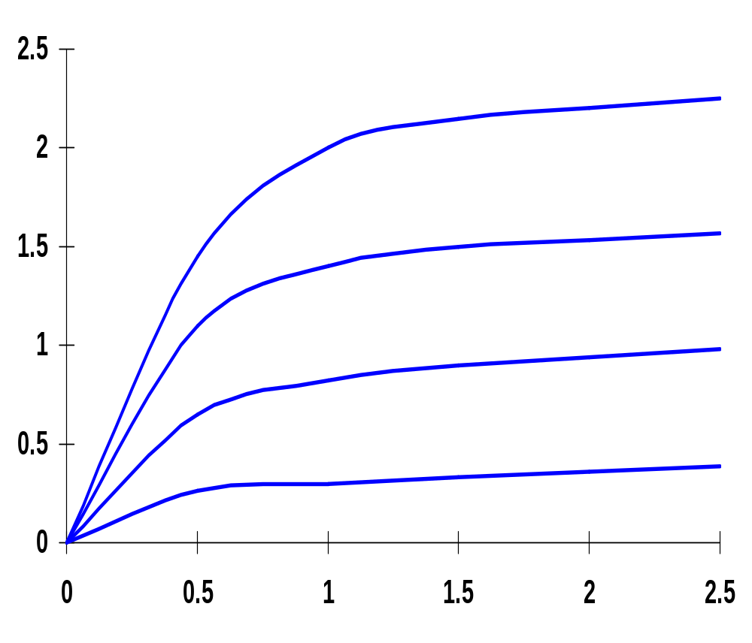
Review: Short Channel I-V Plot (NMOS)
X 10⁻⁴
V_{GS} = 2.5V
V_{GS} = 2.0V
I_{D} (A)
V_{GS} = 1.5V
Linear dependence
V_{GS} = 1.0V
V_{DS} (V)
NMOS transistor, 0.25um, L_{d} = 0.25um, W/L = 1.5, V_{DD} = 2.5V, V_{T} = 0.4V
Notes:
Ld is drawn length
Linear dependence of saturation current wrt VGS
Velocity saturation causes device to saturate for substantially smaller values of VDS.
Results in a substantial drop in current drive for high voltage levels.
Eg at VGS = 2.5V and VDS = 2.5V, the drain current of the short channel device is only 40% of the corresponding value of the long channel device (220 uA versus 540 uA)

Slide 8
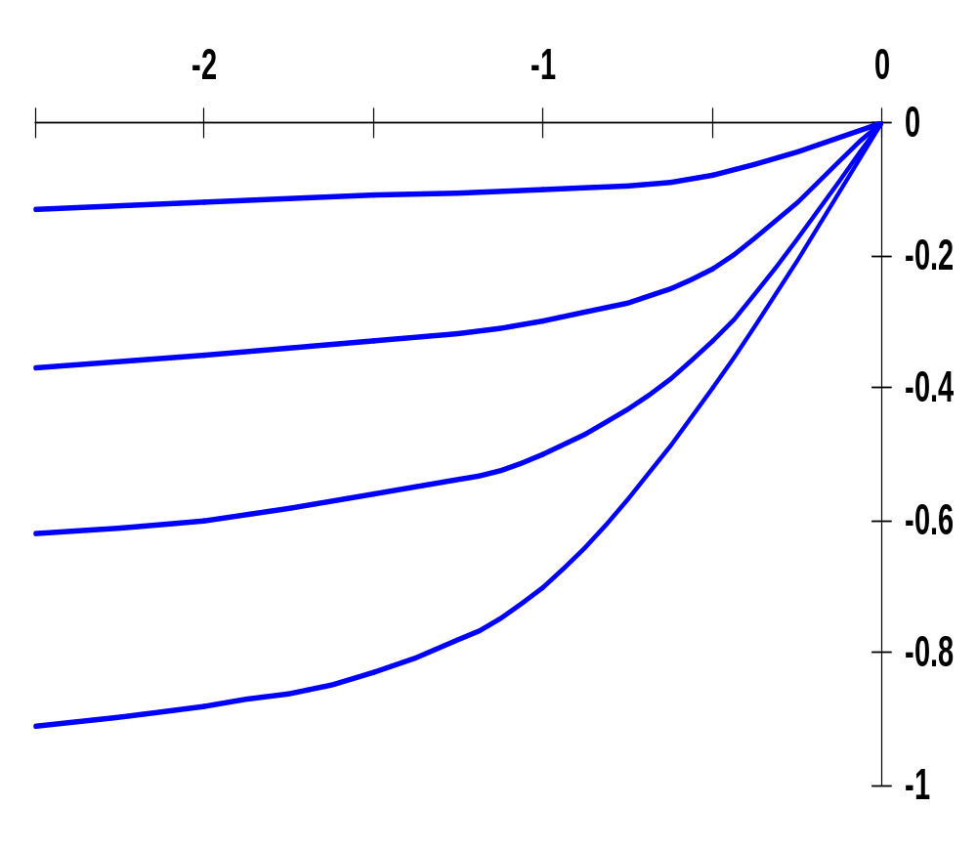
Review: Short Channel I-V Plot (PMOS)
All polarities of all voltages and currents are reversed
V_{DS} (V)
V_{GS} = -1.0V
V_{GS} = -1.5V
I_{D} (A)
V_{GS} = -2.0V
V_{GS} = -2.5V
X 10⁻⁴
PMOS transistor, 0.25um, L_{d} = 0.25um, W/L = 1.5, V_{DD} = 2.5V, V_{T} = -0.4V
Notes:
All the derived equations hold for PMOS – for PMOS devices the polarities of all voltages and currents are reversed
Due to lower mobility, the maximum current is only 42% of what is achieved by a similar NMOS transistor
Effects of velocity saturation are less pronounced than in NMOS (smaller mobility of holes act electrons)

Slide 9
Transforming PMOS I-V Lines
Want common coordinate set V_{in}, V_{out}, and I_{Dn}
I_{Dn}
I_{DSp} = -I_{DSn}
V_{GSn} = V_{in} ; V_{GSp} = V_{in} - V_{DD}
V_{DSn} = V_{out} ; V_{DSp} = V_{out} - V_{DD}
V_{out}
V_{in} = 0
V_{in} = 0
V_{in} = 1.5
V_{in} = 1.5
V_{GSp} = -1
Mirror around x-axis
V_{in} = V_{DD} + V_{GSp}
I_{Dn} = -I_{Dp}
Horiz. shift over V_{DD}
V_{out} = V_{DD} + V_{DSp}
V_{GSp} = -2.5
Notes:
Do inverter transistor schematic on the board labeling all sources, drains, and gates.

Slide 10
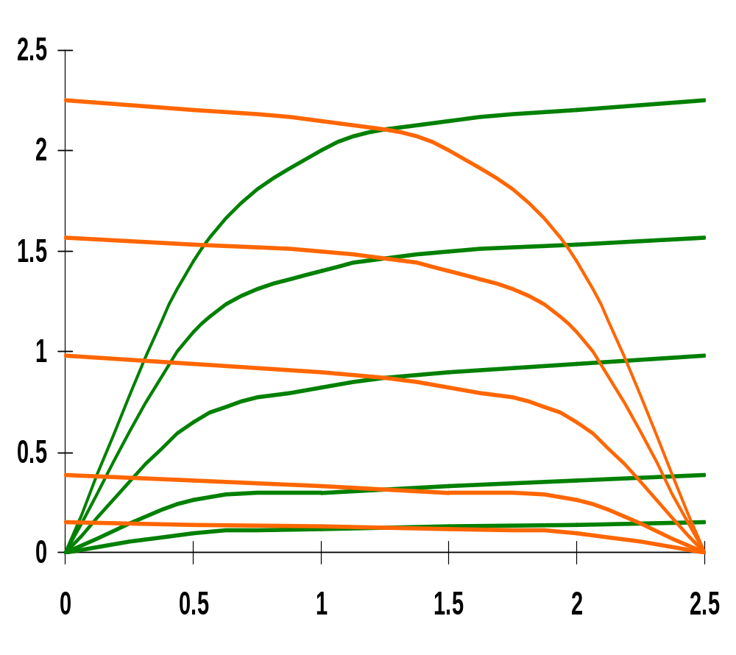
CMOS Inverter Load Lines
PMOS
X 10⁻⁴
NMOS
V_{in} = 0V
V_{in} = 2.5V
V_{in} = 0.5V
V_{in} = 2.0V
I_{Dn} (A)
V_{in} = 1.0V
V_{in} = 1V
V_{in} = 1.5V
V_{in} = 1.5V
V_{in} = 2V
V_{in} = 0.5V
V_{in} = 1.5V
V_{in} = 1.0V
V_{in} = 2.0V
V_{in} = 0.5V
V_{in} = 2.5V
V_{in} = 0V
V_{out} (V)
0.25um, W/L_{n} = 1.5, W/L_{p} = 4.5, V_{DD} = 2.5V, V_{Tn} = 0.4V, V_{Tp} = -0.4V
Notes:
dc points located at the intersection of the corresponding load lines
Note all operating points are located either at the high or low output levels

Slide 11
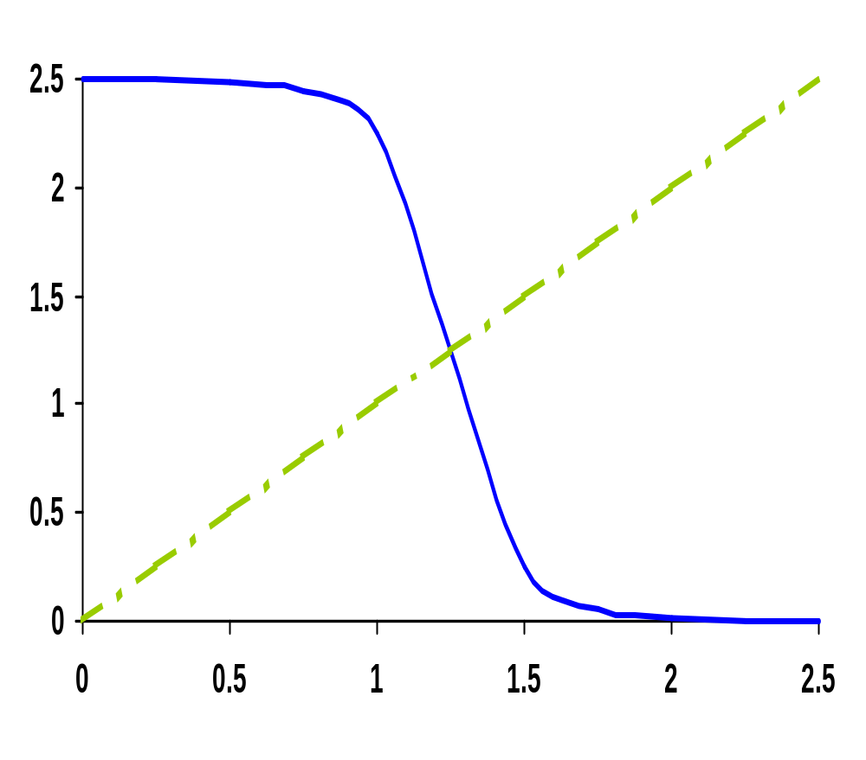
CMOS Inverter VTC
V_{out} (V)
V_{in} (V)
Notes:
For class handout – hide for class

Slide 12
CMOS Inverter VTC
NMOS off
PMOS res
NMOS sat
PMOS res
NMOS sat
PMOS sat
V_{out} (V)
NMOS res
PMOS sat
NMOS res
PMOS off
V_{in} (V)
Notes:
For lecture
VTC of the inverter exhibits a very narrow transition zone; high gain during switching transient (when both PMOS and NMOS are simultaneously on and in saturation). In that region, a small change in input voltage results in a large output voltage variation.
Indicate on VTC plot where VTn and VTp lie

Slide 13
CMOS Inverter:
Switch Model of Dynamic Behavior
V_{DD}
V_{DD}
R_{p}
V_{out}
V_{out}
C_{L}
C_{L}
R_{n}
V_{in} = 0
V_{in} = V _{DD}
Notes:
For handouts. Hide for class.

Slide 14
CMOS Inverter:
Switch Model of Dynamic Behavior
V_{DD}
V_{DD}
R_{p}
V_{out}
V_{out}
C_{L}
C_{L}
R_{n}
V_{in} = 0
V_{in} = V _{DD}
Gate response time is determined by the time to charge C_{L} through R_{p} (discharge C_{L} through R_{n})
Notes:
For class.
response determined mainly by the output capacitance of the gate, CL - drain diffusion capacitance of the NMOS and PMOS transistors; the connecting wires, and the input capacitances of the fan-out gates
A fast gate is built either by keeping the output capacitance small or by decreasing the on-resistance or the transistor (or both)
Decreasing the on-resistance achieved by increasing the W/L ratio of the device
Be award that the on-resistance of the NMOS and PMOS transistors is not constant; rather it is a nonlinear function of the voltage across the transistor

Slide 15
Relative Transistor Sizing
When designing static CMOS circuits, balance the driving strengths of the transistors by making the PMOS section wider than the NMOS section to
  maximize the noise margins and
  obtain symmetrical characteristics

Slide 16
Switching Threshold
V_{M} where V_{in} = V_{out} (both PMOS and NMOS in saturation since V_{DS} = V_{GS})
V_{M} ≈ rV_{DD}/(1 + r) where r = k_{p}V_{DSATp}/k_{n}V_{DSATn}
Switching threshold set by the ratio r, which compares the relative driving strengths of the PMOS and NMOS transistors
Want V_{M} = V_{DD}/2 (to have comparable high and low noise margins), so want r ≈ 1
(W/L)_{p} k_{n}’V_{DSATn}(V_{M}-V_{Tn}-V_{DSATn}/2)
(W/L)_{n} k_{p}’V_{DSATp}(V_{DD}-V_{M}+V_{Tp}+V_{DSATp}/2)
=
Notes:
Assumes: The supply voltage is high enough so that the devices are velocity-saturated (VDSAT < VM – VT) and ignores channel length modulation.
Reminder:
k = k’W/L and k’ = mu Cox (mu is carrier mobility)
Larger r to move VM upwards means making the PMOS wider
Smaller r to move VM downwards means making the NMOS wider

Slide 17
Switch Threshold Example
In our generic 0.25 micron CMOS process, using the process parameters from slide L03.25, a V_{DD} = 2.5V, and a minimum size NMOS device ((W/L)_{n} of 1.5)
 | V_{T0}(V) | γ(V^{0.5}) | V_{DSAT}(V) | k’(A/V²) | λ(V⁻¹)
NMOS | 0.43 | 0.4 | 0.63 | 115 x 10⁻⁶ | 0.06
PMOS | -0.4 | -0.4 | -1 | -30 x 10⁻⁶ | -0.1
(W/L)_{p}
(W/L)_{n}
=
Notes:
For handout

Slide 18
Switch Threshold Example
In our generic 0.25 micron CMOS process, using the process parameters from slide L03.25, a V_{DD} = 2.5V, and a minimum size NMOS device ((W/L)_{n} of 1.5)
 | V_{T0}(V) | γ(V^{0.5}) | V_{DSAT}(V) | k’(A/V²) | λ(V⁻¹)
NMOS | 0.43 | 0.4 | 0.63 | 115 x 10⁻⁶ | 0.06
PMOS | -0.4 | -0.4 | -1 | -30 x 10⁻⁶ | -0.1
(W/L)_{p} 115 x 10⁻⁶ 0.63 (1.25 – 0.43 – 0.63/2)
(W/L)_{n} -30 x 10⁻⁶ -1.0 (1.25 – 0.4 – 1.0/2)
=
x
x
= 3.5
(W/L)_{p} = 3.5 x 1.5 = 5.25 for a V_{M} of 1.25V
Notes:
For class
goal is to have Vm at Vdd/2
3.5 x 1.5 so (W/L)p = 5.25

Slide 19
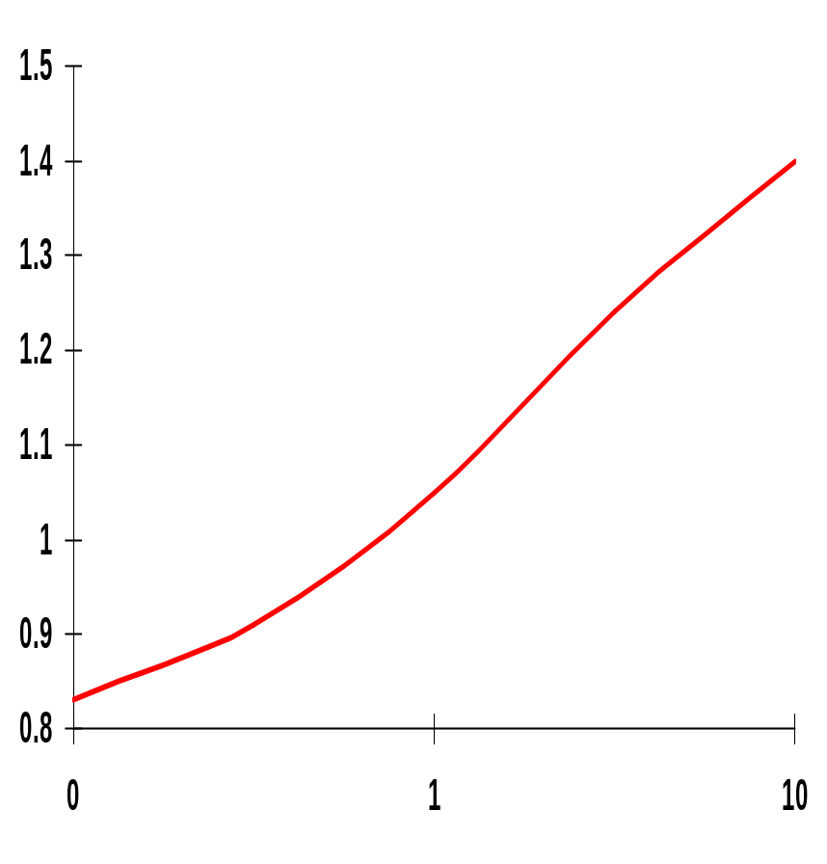
Simulated Inverter V_{M}
V_{M} is relatively insensitive to variations in device ratio
  setting the ratio to 3, 2.5 and 2 gives V_{M}’s of 1.22V, 1.18V, and 1.13V
Increasing the width of the PMOS moves V_{M} towards V_{DD}
Increasing the width of the NMOS moves V_{M} toward GND
V_{M} (V)
.1
~3.4
(W/L)_{p}/(W/L)_{n}
Note: x-axis is semilog
Notes:
Plot needs work – but it’s the best I could do with powerpoint graphing
Small variations in ratio don’t make a lot of difference
To move the VM to 1.5V requires a ratio of 11 !!!
Note that the x axis is semilog

Slide 20
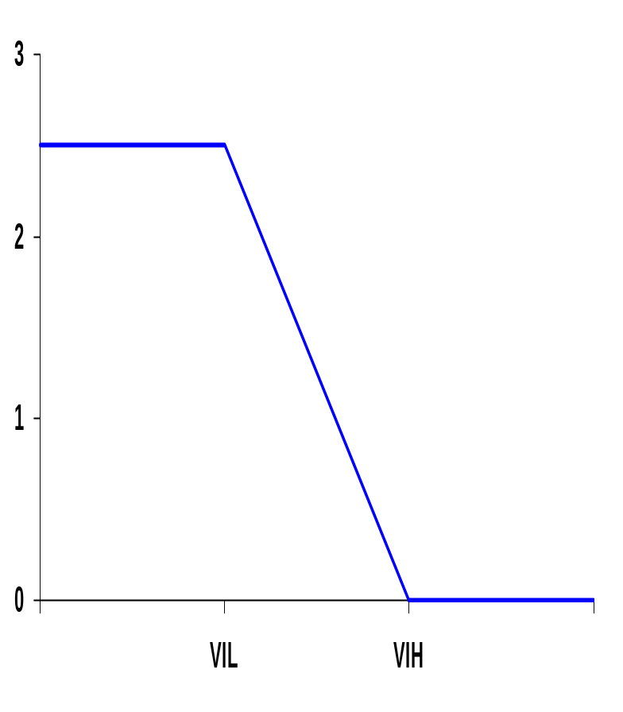
Noise Margins Determining V_{IH} and V_{IL}
By definition, V_{IH} and V_{IL} are where dV_{out}/dV_{in} = -1 (= gain)
V_{OH} = V_{DD}
NM_{H} = V_{DD} - V_{IH}
NM_{L} = V_{IL} - GND
Approximating:
V_{IH} = V_{M} - V_{M} /g
V_{IL} = V_{M} + (V_{DD} - V_{M} )/g
So high gain in the transition region is very desirable
V_{out}
V_{M}
V_{OL} = GND
V_{in}
A piece-wise linear approximation of VTC
Notes:
A high gain in the transition region is VERY desirable. In the extreme case of an infinite gain, the noise margins simplify to VOH – VM and VM – VOL for NMH (ideally, VDD – VM) and NML (ideally, VM – GND), respectively, and span the complete voltage swing.

Slide 21
CMOS Inverter VTC from Simulation
0.25um, (W/L)_{p}/(W/L)_{n} = 3.4
(W/L)_{n} = 1.5 (min size)
V_{DD} = 2.5V
V_{M} ≈ 1.25V, g = -27.5
V_{IL} = 1.2V, V_{IH} = 1.3V
NM_{L} = NM_{H} = 1.2
(actual values are V_{IL} = 1.03V, V_{IH} = 1.45V
NM_{L} = 1.03V & NM_{H} = 1.05V)
Output resistance low-output = 2.4kΩ
high-output = 3.3kΩ
V_{out} (V)
V_{in} (V)
Notes:
Note: simulation overestimates the gain – as seen on the next slide, the maximum gain (at VM) is only -17
And piece-wise linear approximation model is optimistic wrt noise margins.
Low output resistance is a good measure of the sensitivity of the gate wrt noise induced at the output and should be as low as possible.

Slide 22
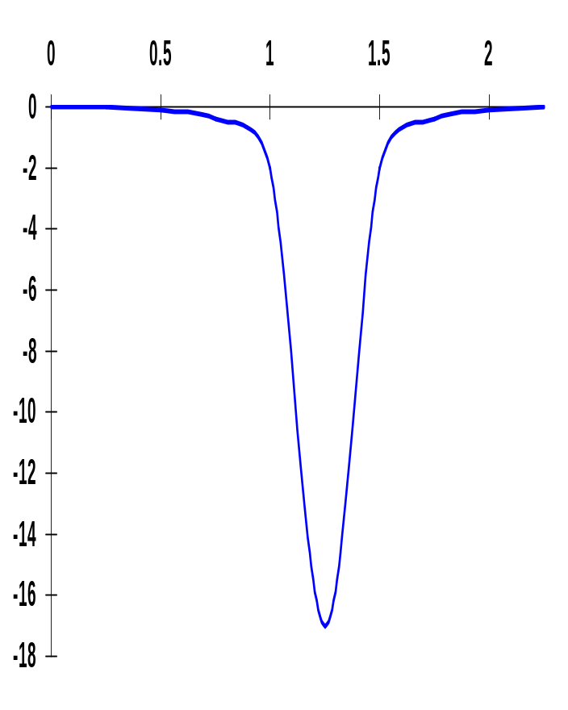
Gain Determinates
V_{in}
Gain is a strong function of the slopes of the currents in the saturation region, for V_{in} = V_{M}
(1+r)
g ≈ ----------------------------------
(V_{M}-V_{Tn}-V_{DSATn}/2)(λ_{n} - λ_{p} )
Determined by technology parameters, especially channel length modulation (λ). Only designer influence through supply voltage and V_{M} (transistor sizing).
gain

Slide 23
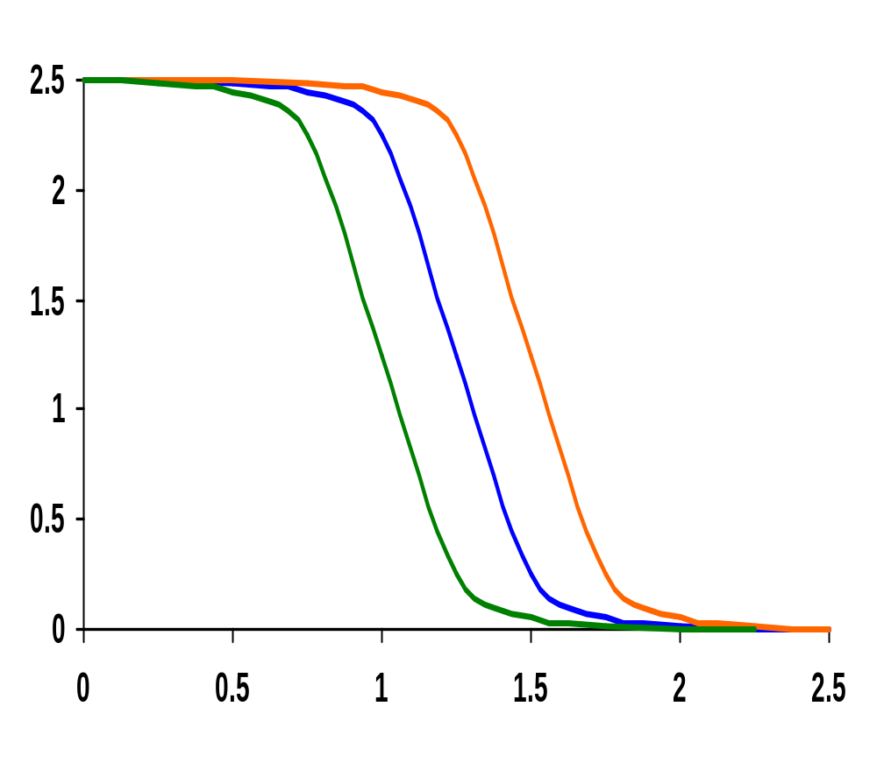
Impact of Process Variation on VTC Curve
Good PMOS
Bad NMOS
V_{out} (V)
Nominal
Bad PMOS
Good NMOS
V_{in} (V)
Process variations (mostly) cause a shift in the switching threshold
Notes:
A good device has a small oxide thickness (-3nm), a small length (-25nm), a higher width (+30nm) and a smaller threshold (-60mV). The opposite is true for a bad device.

Slide 24
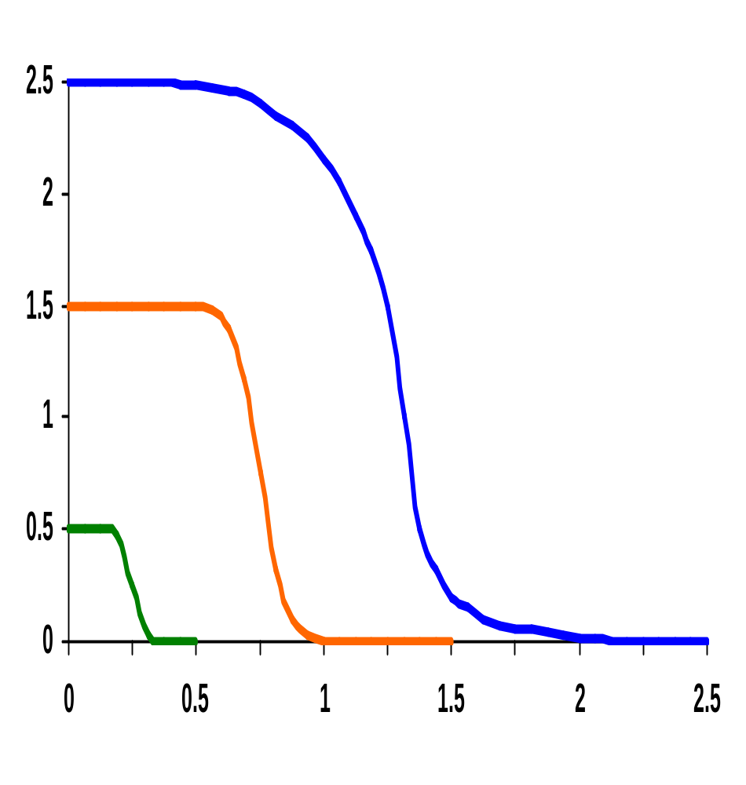
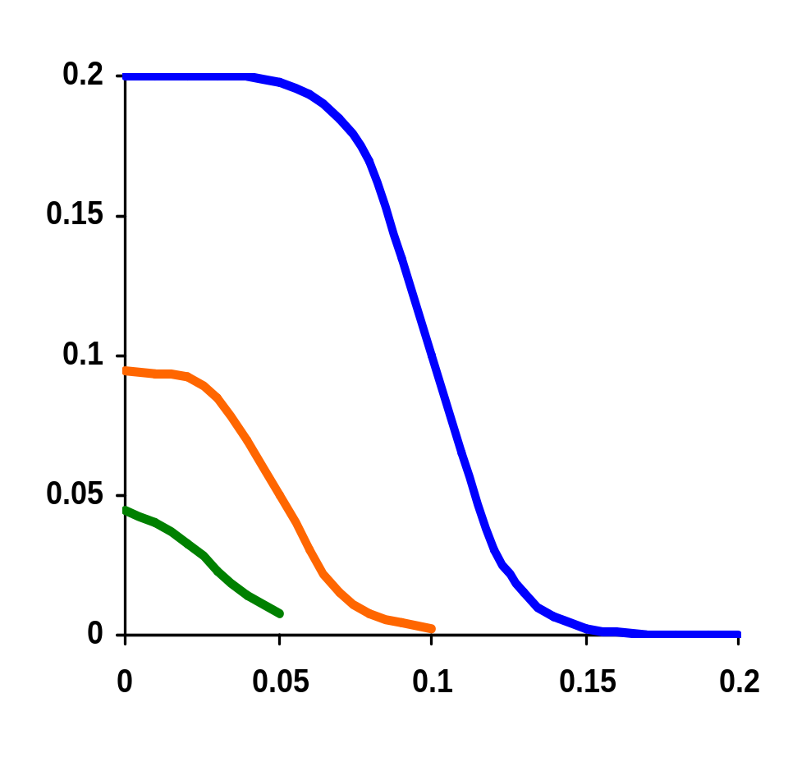
Scaling the Supply Voltage
V_{out} (V)
V_{out} (V)
Gain=-1
V_{in} (V)
V_{in} (V)
Device threshold voltages are kept (virtually) constant
Device threshold voltages are kept (virtually) constant
Notes:
Not the best curve for 0.5 supply (but the best I could do in ppt).
Observations
The gain of the inverter in the transition region increases with a reduction in Vdd. For a fixed r, VM is proportional to Vdd.
At a voltage of 0.5V (just 100mV above the threshold of the transistors) the width of the transition region measures only 10% of the supply voltage (and a gain of -35), while it widens to 17% for 2.5V
But, reducing the supply
Is absolutely detrimental to the performance of the gate
The dc characteristics become increasingly sensitive to variations in the device parameters (e.g., VT)
Scaling the supply means reduced signal swing making the gate more sensitive to external noise sources that don’t scale
Note, in plot on the right, we still obtain an inverter even though the supply voltage is not large enough to turn the transistors on! The subthreshold current is sufficient to switch the gate between low and high levels, as well as to provide enough gain to produce an acceptable VTC.
The ultimate show stopper is when the gain in the transition region approaches 1 (as in the green curve on the right plot) – giving the true lower bound on supply scaling (without cooling the chip).

Slide 25
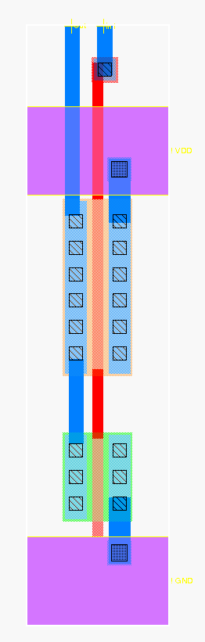
Next Time: CMOS Inverter max Layout
Out
In
metal1-poly via
metal1
polysilicon
metal2
V_{DD}
pdiff
PMOS (4/.24 = 16/1)
NMOS (2/.24 = 8/1)
metal1-diff via
ndiff
GND
metal2-metal1 via

Slide 26
Next Lecture and Reminders
Next lecture
  IC manufacturing
    Reading assignment – Rabaey, et al, 2.1-2.3
Reminders
  HW1 due September 10th (next lecture!)
  Project Title due September 12th (one week)
  Evening midterm exam scheduled
    Wednesday, October 10th from 8:15 to 10:15pm in 260 Willard
    Only one midterm conflict filed for so far

